Slide 1
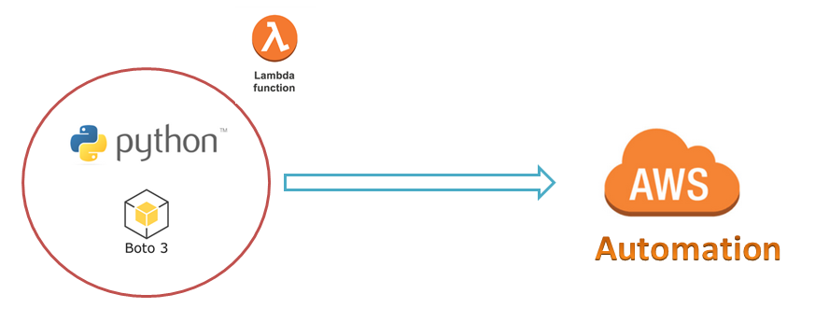
AWS Automation
with
boto3 of Python and Lambda Functions
Loop control statements or commands
(break and continue)
Introduction to boto3
Learn how to automate AWS common tasks using boto3 and Lambda

Slide 2

Introduction to boto3
Boto3 is the name of the Python SDK for AWS.
Boto3 allows us to directly create, update, and delete AWS services from our Python scripts.
Boto3 is built on the top of botocore module.
We have to Install boto3 to work with AWS Services using Python Scripts.
How to install boto3 ?
Python-2.x:
pip install boto3
Python-3.x
pip3 install boto3
Loop control statements or commands
(break and continue)
Learn how to automate AWS common tasks using boto3 and Lambda

Slide 3
Thank you

